Slide 1
IoT-Hackathon StayFocussed Jutta Degele, Sascha Krauß, Julia Hain, Manh Phi Nguyen GitHub Repository: https://github.com/jules185/IoT_Hackathon/wiki
Internet of Things, Prof. Decker, 13.06.2017

Slide 2
Project Goal
Develop a service enabling improved concentration during lectures, more flexible scheduling of breaks, enhanced productivity, unified break start and ends.
The service should be based on human and sensor input and should give break and other recommendations to the lecturer.

Slide 3
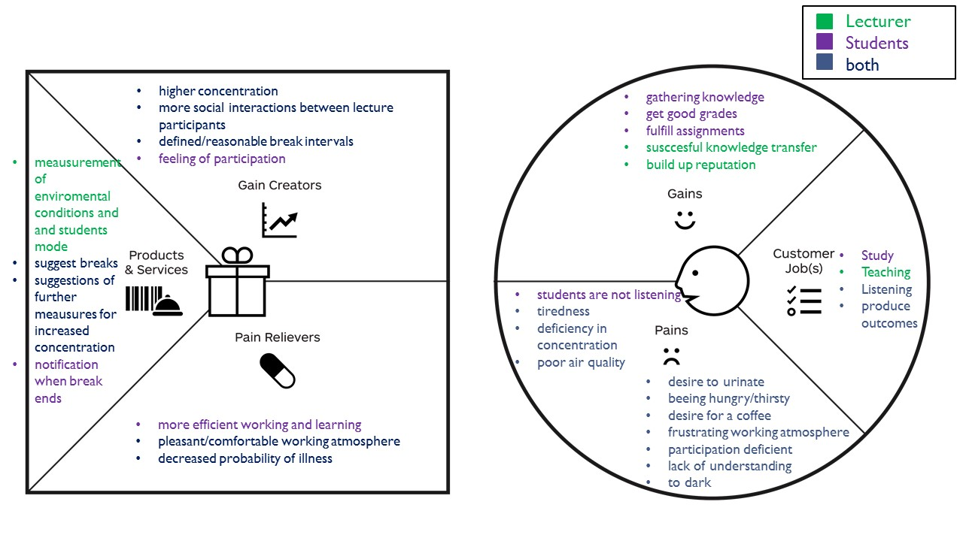
Value Proposition Design

Slide 4






Minimum Viable Product
Brightness
Telegram Bot
CO2 Sensor
Break Scoring +
Suggestion
Traffic Light Status
Telegram Bot
Student Webpage
Home Assistant Dashboard
Notes:
Telegram <div>Icons made by <a href="http://www.flaticon.com/authors/designerz-base" title="Designerz Base">Designerz Base</a> from <a href="http://www.flaticon.com" title="Flaticon">www.flaticon.com</a> is licensed by <a href="http://creativecommons.org/licenses/by/3.0/" title="Creative Commons BY 3.0" target="_blank">CC 3.0 BY</a></div>
Sun<div>Icons made by <a href="http://www.flaticon.com/authors/lucy-g" title="Lucy G">Lucy G</a> from <a href="http://www.flaticon.com" title="Flaticon">www.flaticon.com</a> is licensed by <a href="http://creativecommons.org/licenses/by/3.0/" title="Creative Commons BY 3.0" target="_blank">CC 3.0 BY</a></div>
Co2 <div>Icons made by <a href="http://www.flaticon.com/authors/vectors-market" title="Vectors Market">Vectors Market</a> from <a href="http://www.flaticon.com" title="Flaticon">www.flaticon.com</a> is licensed by <a href="http://creativecommons.org/licenses/by/3.0/" title="Creative Commons BY 3.0" target="_blank">CC 3.0 BY</a></div>
Light bulb <div>Icons made by <a href="http://www.flaticon.com/authors/gregor-cresnar" title="Gregor Cresnar">Gregor Cresnar</a> from <a href="http://www.flaticon.com" title="Flaticon">www.flaticon.com</a> is licensed by <a href="http://creativecommons.org/licenses/by/3.0/" title="Creative Commons BY 3.0" target="_blank">CC 3.0 BY</a></div>
Latop <div>Icons made by <a href="http://www.freepik.com" title="Freepik">Freepik</a> from <a href="http://www.flaticon.com" title="Flaticon">www.flaticon.com</a> is licensed by <a href="http://creativecommons.org/licenses/by/3.0/" title="Creative Commons BY 3.0" target="_blank">CC 3.0 BY</a></div>

Slide 5
Business Model Canvas
BUSINESS MODEL CANVAS
HHZ
Reutlingen University
Other universities
Lecturers
Aggregate sensor information
Make suggestions to enhance learning process
Calculate Score
More alert students
Better break scheduling
Improvement of work atmosphere
Measurement of environmental conditions and students mode
Suggest breaks
Suggestions of further measures for increased concentration
Notification when break ends
Image improvement for university
Online (GIT)
Relax
Word-of-Mouth-Marketing
Students
Professors
Academic workers
Visitors of HHZ
Raspberry Pi
Arduino
Website
Telegram Bot
Home Assistant Dashboard
Scoring algorithm
Sensor network
Website
Dashboard
Telegram Bot
Power bill
Cost of HW infrastructure
Network
Website hosting
Maintenance
Sensor installation
Setup and administration of lecturer accounts
Better image for HHZ
Marketing opportunity
Advertising
Licensing

Slide 6
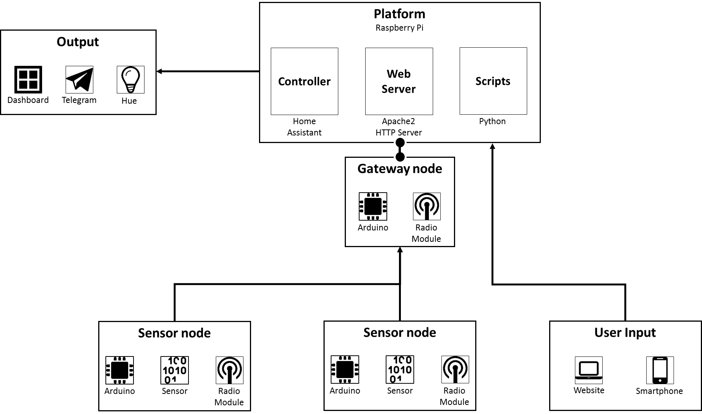
Architecture

Slide 7
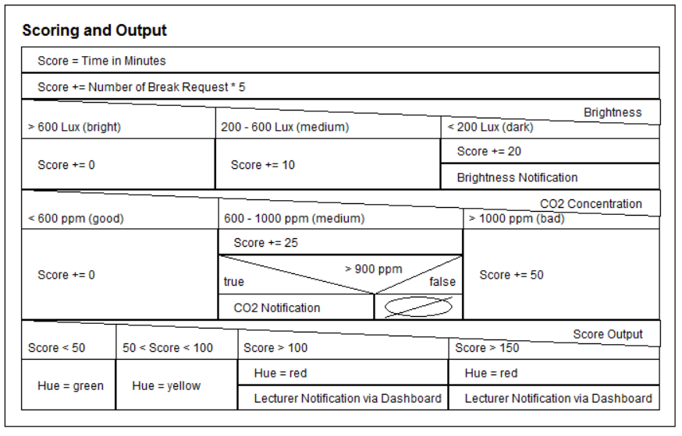
Scoring and Output

Slide 8
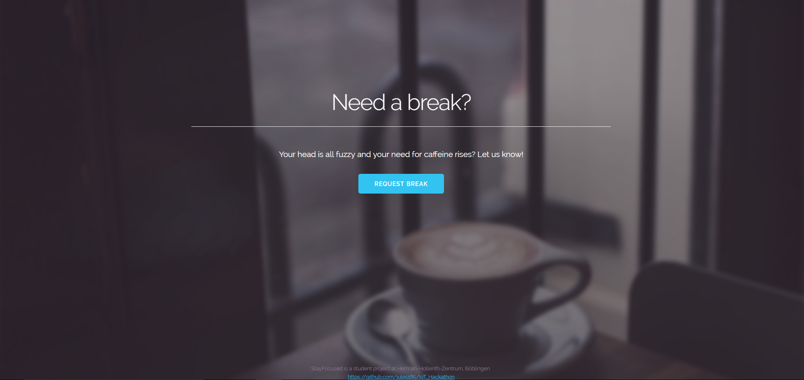
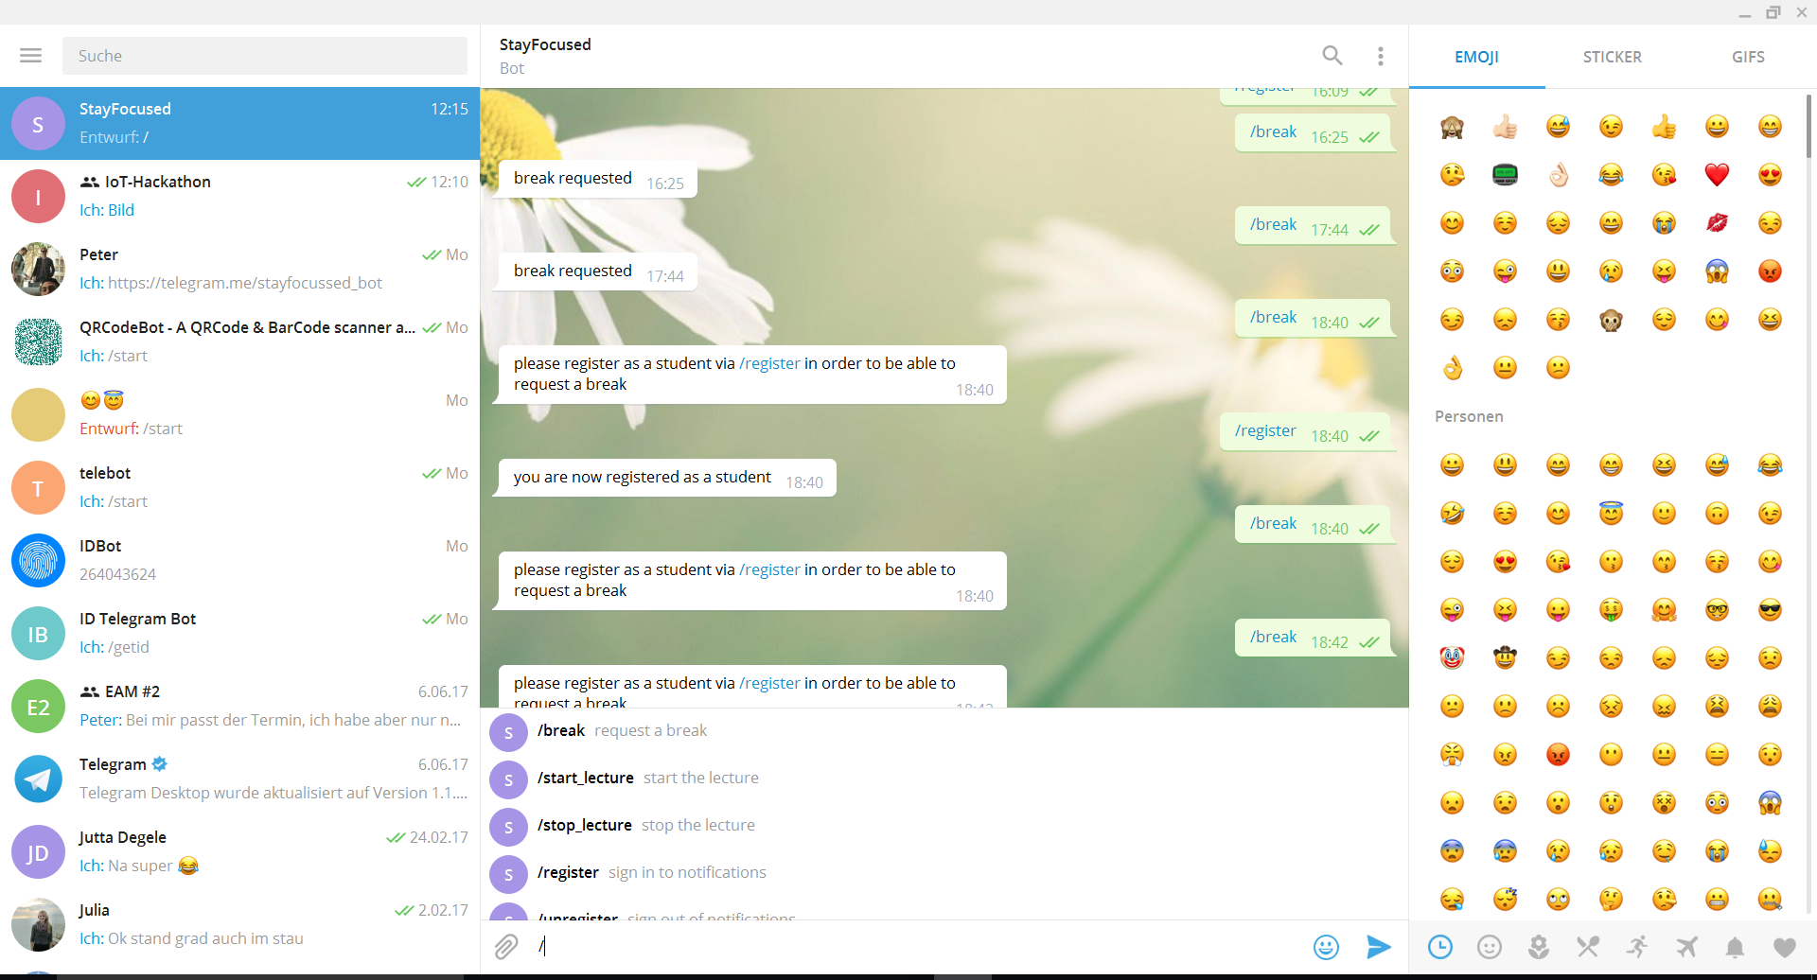

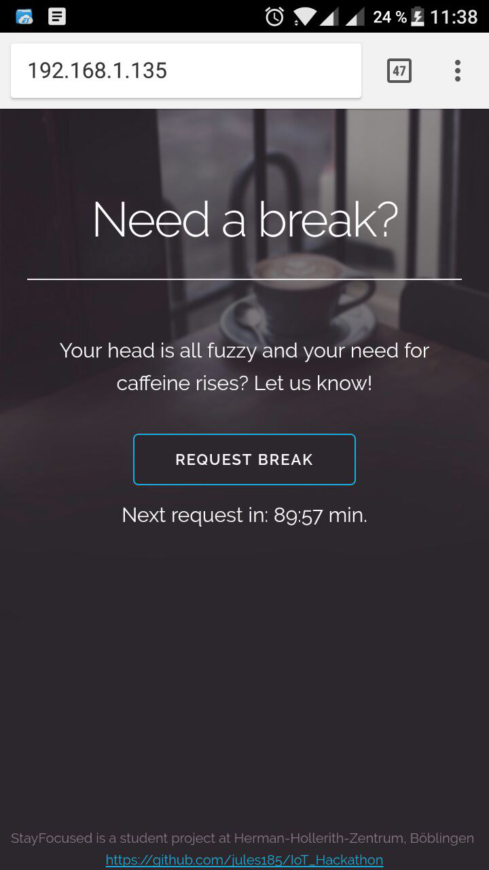
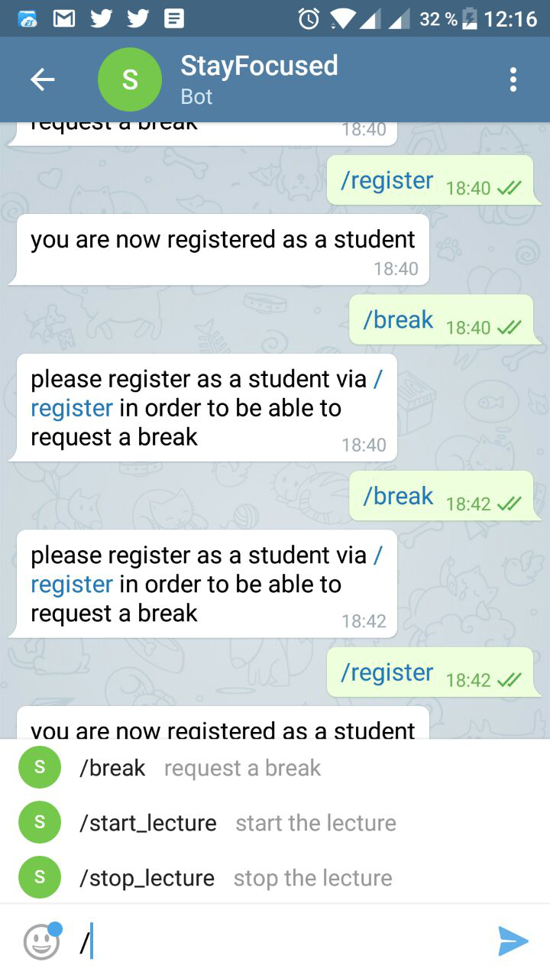
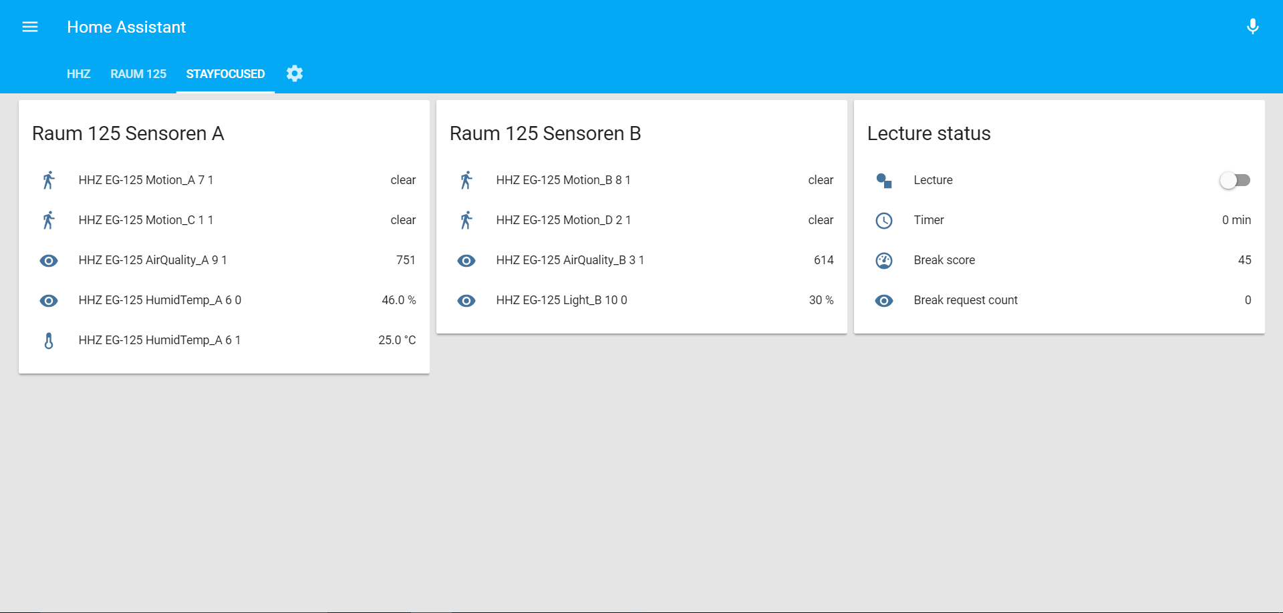

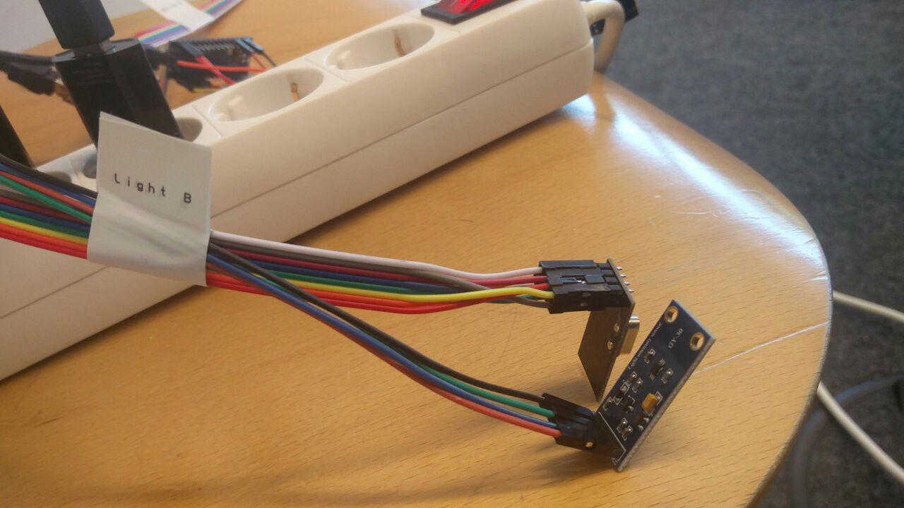
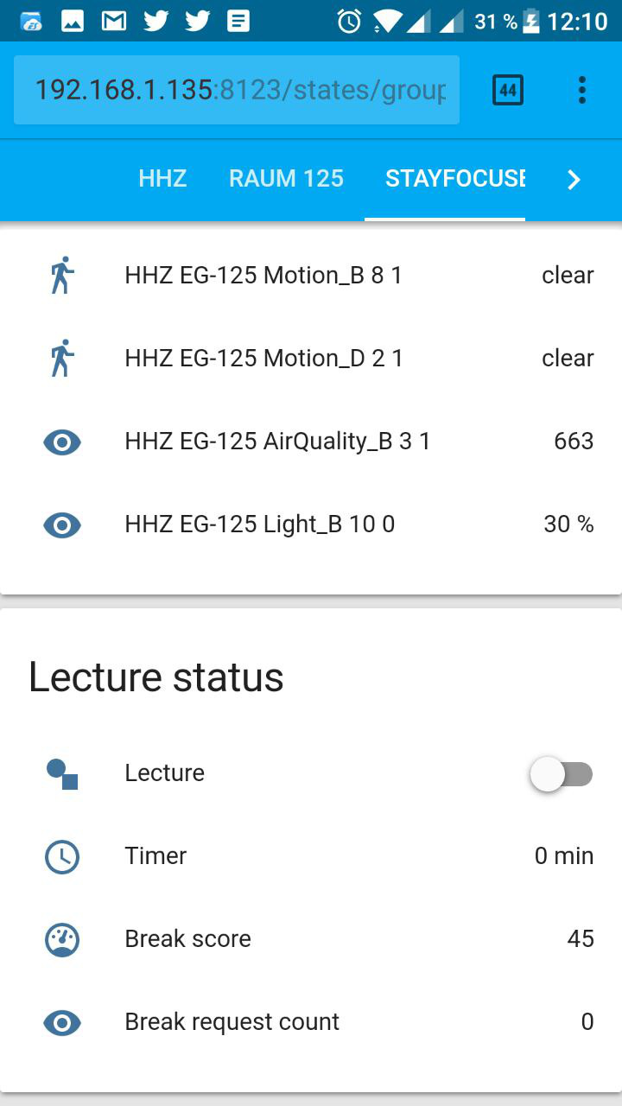
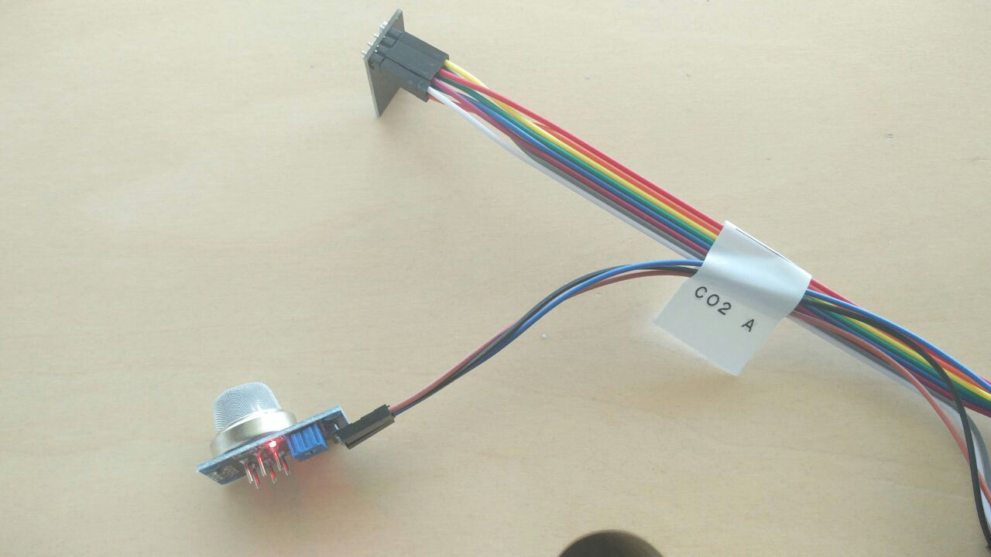
Service Design
Student Webpage – Break Button
Telegram StayFocussed Bot
Lecturer Dashboard
Sensors and Hue Traffic Light

Slide 9
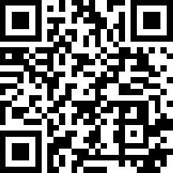
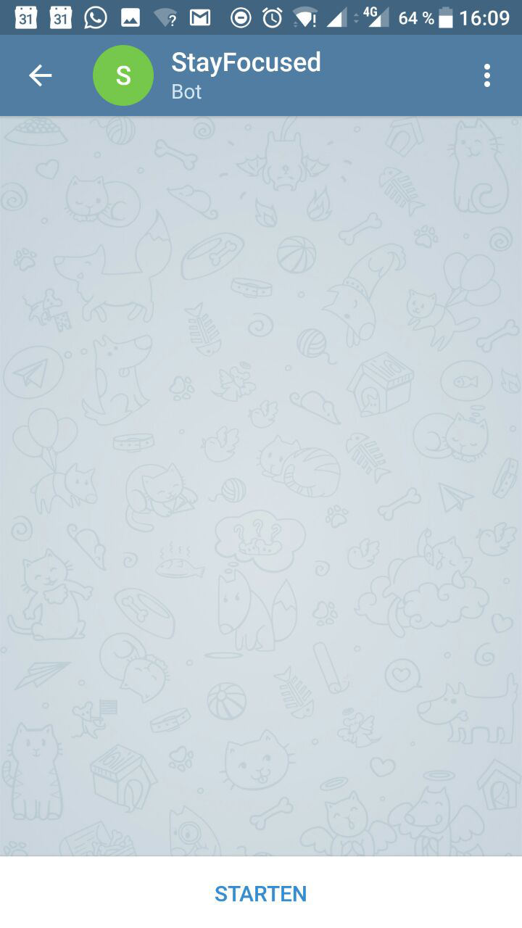

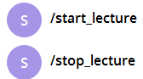
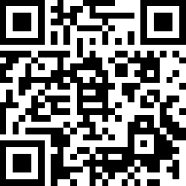
Lecturer Access StayFocussed
1. Scan QR Code or visit https://telegram.me/stayfocussed_bot
2. Open in Telegram
3. On first visit click „Start“ and send /start_lecture to StayFocussedBot to start the lecture
4. Receive break and learning experience suggestions. Stop the lecture with /stop_lecture
Visit Dashboard for Analytic Insights:
Scan QR Code or visit
http://192.168.1.135:8123/states/group.stayfocused
Prerequisite: Your Telegram ID needs to be hardcoded to be authorized as an lecturer.

Slide 10
DEMO

Slide 11
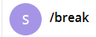
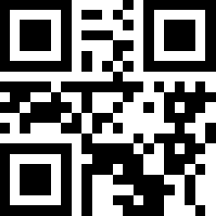
Student Access StayFocussed
1. Scan QR Code or visit https://telegram.me/stayfocussed_bot
2. Open in Telegram
3. On first visit click „Start“ and send /register to StayFocussedBot to register for the current lecture
4. Request /break or get message when lecture break is over
Don`t have Telegram? Use our Webpage …
Scan QR Code or visit
https://telegram.me/stayfocussed_bot

Slide 12
Thank you!

